Slide 1


Swiss Re Document Analytics Recruiting Exercise for Datascience

Slide 2
Exercise 1: Extracting entities from unstructured data
Within Swiss Re a lot of information is stored within unstructured documents. Recognizing entities or tabular content within a document is a challenge across many text mining applications .
Exercise - Use the Swiss Re Financial Report* and extract all the locations (US, Canada, Zurich, …) mentioned in the report and group them together. Create an overview on which page which location was found.
E.g. Canada -> Found on page 1, 2, 5, 9 ,…
- How do you measure the accuracy of the solution you provide?
- Generalize the task from this particular document, to finding locations in any generic document. You can use different documents you find on the web to test your approach. Which challenges do you experience?
You may use the programming language and frameworks/libraries of your choice. Ideally use either Java, R or Python. Please share the code on GitHub with us.
Swiss Re Financial Report http://reports.swissre.com/2015/servicepages/downloads/files/2015_financial_report_swissre_ar15.pdf

Slide 3
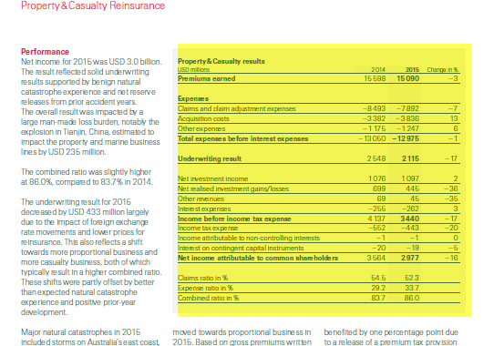
Bonus: Recognition of tables in the annual report
Bonus Exercise
Recognize all the tables within the financial report. Find a suitable way to show all the tables found in the document to the user. (E.g. dump into a text file, highlight in the original document…)

Slide 4
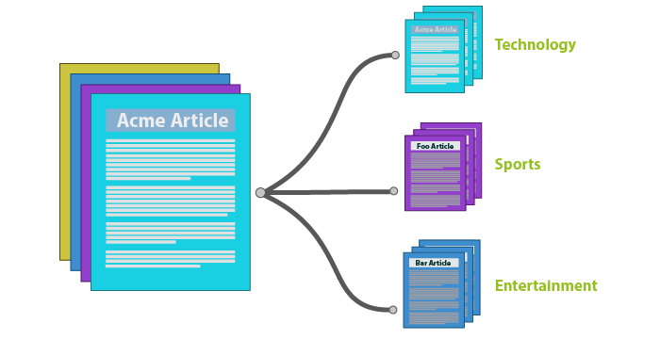
Exercise 2: Classifying news into categories.
Assume you have a set of news articles from the web. You need to classify the news article into one of several categories e.g. Business, Politics, Technology, Sports or Entertainment.
How do you build such a classifier?
What are measures to see how good it is?
Please prepare a full overview (including examples how you would solve this task)
Practical exercise: The sample dataset contains approx. 2000 BBC news articles which fall into the abovementioned 5 categories. Use this dataset to practically implement your classification module.
How accurate is your model?
Which conclusions do you draw?
Data Set: http://mlg.ucd.ie/files/datasets/bbc-fulltext.zip
Programming language/frameworks/tools: free choice
Please share your code on GitHub with us.

Slide 5
Exercise 3: General Data Science questions
Imaging you have 5 TB of PDF documents. You want to know if there any particular patterns within this documents. (E.g. Documents which are similar, documents which are duplicates, …).
Please explain the following points using no more than150 words for every point
How do you process the documents?
Which visualization do you chose to illustrate the data?
Which technology do you use to perform this task. Why?
How long do you assume the process will take?
If the processing time is too long – how can you speed up the process?

